Slide 1
Thinking in Modules
Leo D’Arcy

Slide 2

Who am I
Leo D’Arcy
Senior Consultant
PowerON Platforms
Twitter: @LeoDArcy1
GitHub: ld0614

Slide 3
Agenda
Modules – What, Why and How
Source Control – Why and Who
Template Pipeline
Testing – Don’t Panic!

Slide 4
PowerShell Modules

Slide 5
What is a Module?
A collection of cmdlets
A collection of Functions which can be called directly
Stored or referenced from a master script (.psm1) allowing for shared variables
Allows the use of a metadata file (.psd1) to ease loading and distribution

Slide 6
Why Use Modules?
Know locations make loading easy
Version Control allows for automatic updating
Minimises code duplication
Hide complexity from module consumers

Slide 7
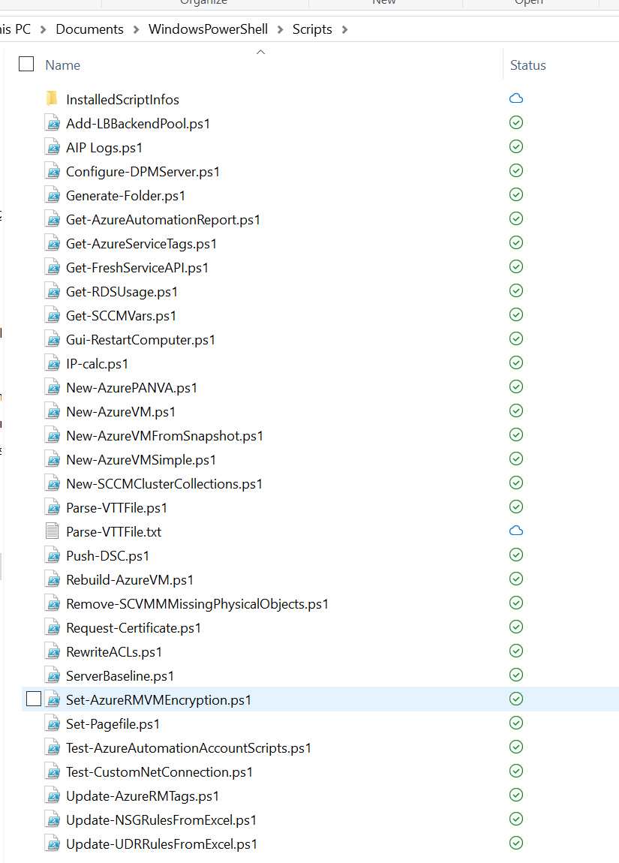
Convert Scripts to Modules
Convert each script into a function
Consolidate shared logic into dedicated functions
Unify naming where possible
Create environment handling logic where needed
Create Module Manifest (.psd1)

Slide 8
Script to Module Conversion DEMO
Notes:
Create Module Folder
Create Module psm1 file
Create Module psd1 file New-ModuleManifest
Convert to Function
Add cmdletbinding
Add param section and Mandatory parameters
Modify outputpath to be optional parameter

Slide 9
Source Control

Slide 10
Common Source Control Protocols
Git
TFVC
SVN
Mercurial
CVS

Slide 11
Common Source Control Services
Azure DevOps (Formally Team Foundation Server / Visual Studio Online)
GitHub
GitLab
BitBucket
TeamCity

Slide 12
Git –ne GitHub

Slide 13
Why Azure DevOps?
Hosted Solution
Supports TFVC and Git
Free for 5 users
Work Tracker
Includes Pipelines, Tests, Artefacts and Wiki
Azure AD Integrated

Slide 14
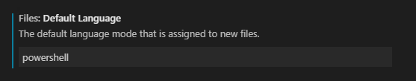
Environment Setup
VS Code
Extensions
PowerShell
Azure Repos
Live Share
Better Comments
Code Spell Checker
Git Extension Pack
Default Language
Git

Slide 15
Source Control DEMO
Notes:
Clone the github
Create new project
Rename files
Rename module name in files
Deploy pipeline
Set up code signing password
Create artefact store
Update pipeline with store ID

Slide 16
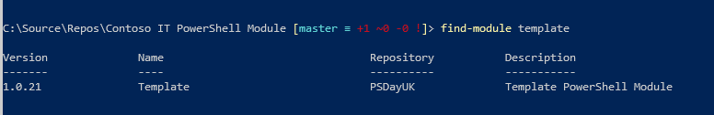
Soon…

Slide 17
Testing

Slide 18
Should you Test?
Yes…
But not at the expense of other things
Start small
Look at the business value
Invest where it makes sense

Slide 19
Unit vs Integration Tests
Unit Tests
Tests of code logic
Highly recommended for Checker Functions
Test-VMName
Test-Username
No additional infrastructure should be needed
Integration Tests
Tests code effects
Makes end to end changes
Recommended for critical code
Often requires infrastructure

Slide 20
To Conclude
Use Source Control
Enables easy rollback
Enhances collaboration
Required for Automation
Sets up for CI/CD
Testing is desirable
Little and occasional is better than none
Concentrate on high value targets
Pester is flexible

Slide 21
Twitter: @LeoDArcy1
GitHub: ld0614

Slide 22
Twitter: @LeoDArcy1
GitHub: ld0614

Slide 23
Twitter: @LeoDArcy1
GitHub: ld0614

Slide 24
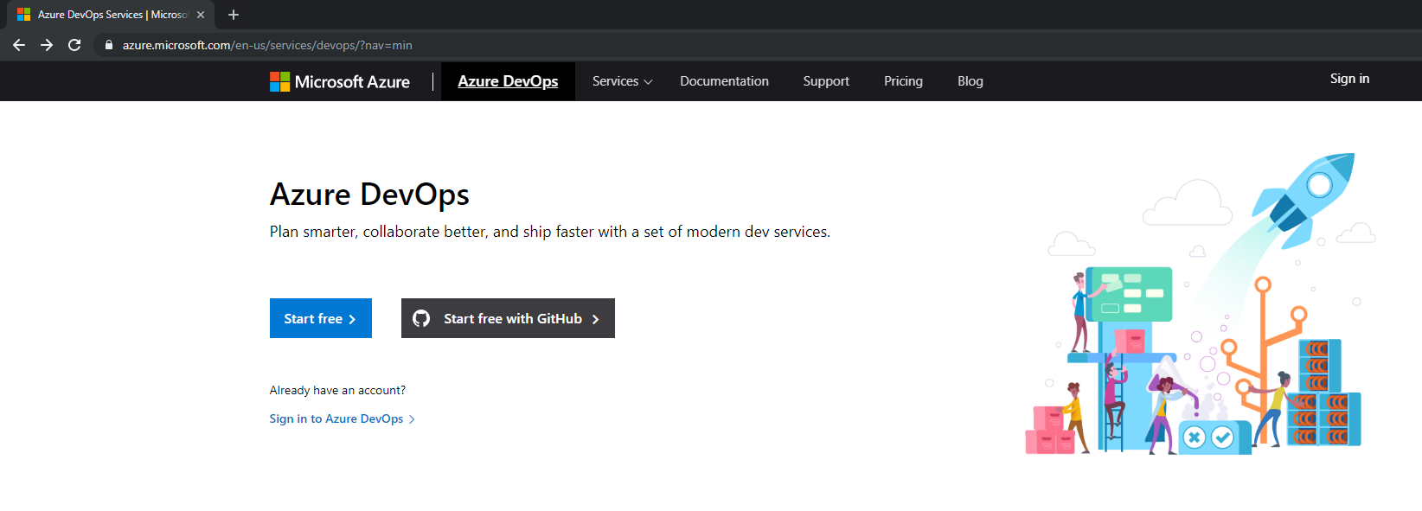
Dev.Azure.com

Slide 25
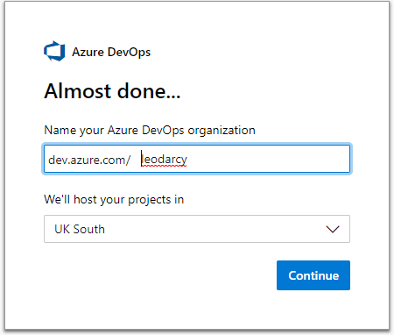
Create Organisation

Slide 26
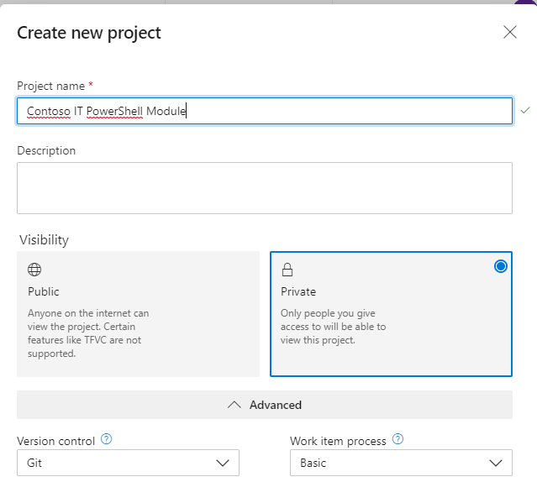
Create Project

Slide 27
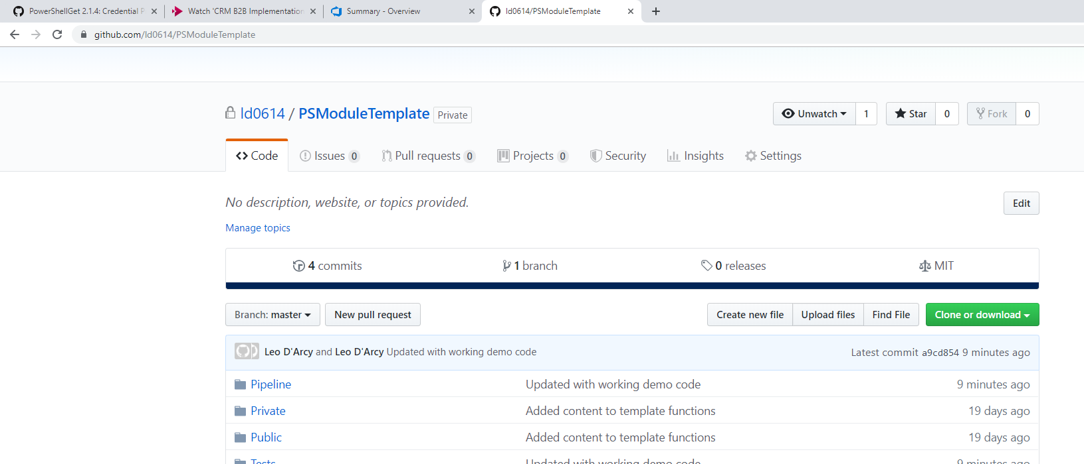
Github.com/ld0614/PSModuleTemplate

Slide 28
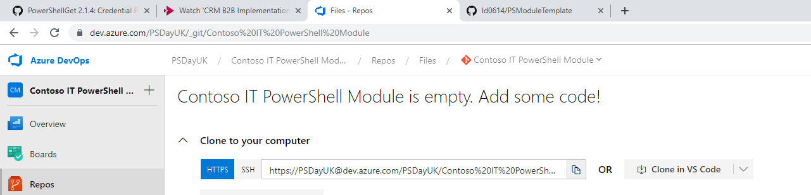
Clone the Repo

Slide 29
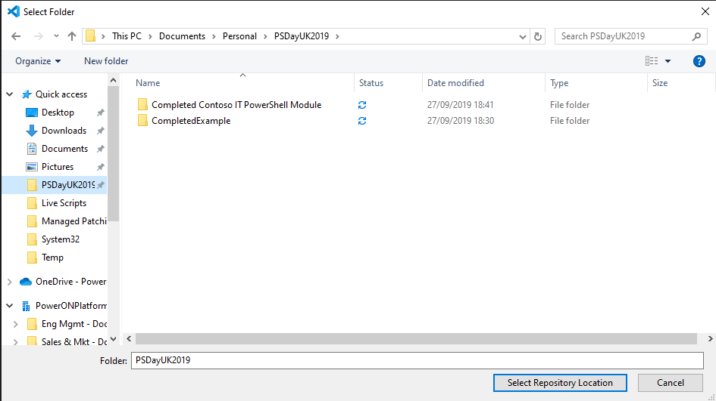
Select Root Folder

Slide 30
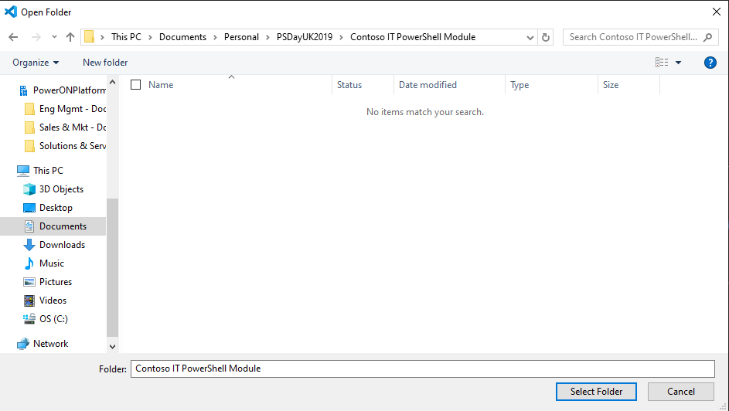
Open Folder in VS Code

Slide 31
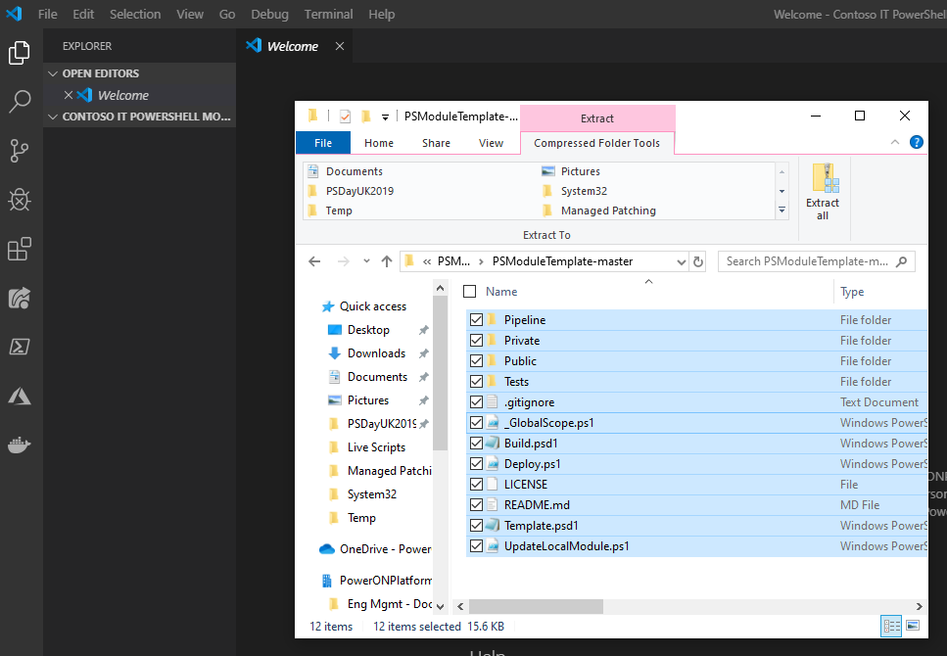
Copy github code into VS Code

Slide 32
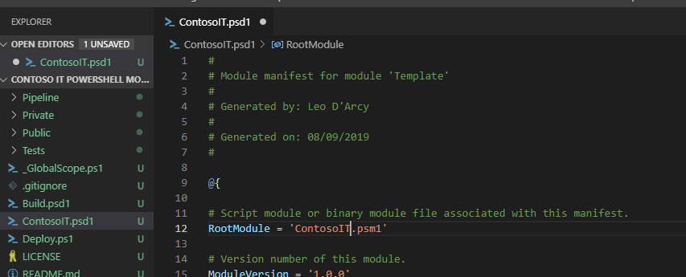
Update Module Manifest

Slide 33
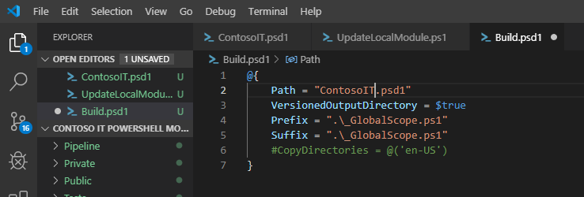
Update Build file

Slide 34
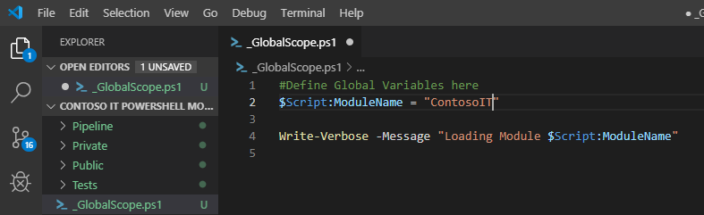
Update _GlobalScope.ps1

Slide 35
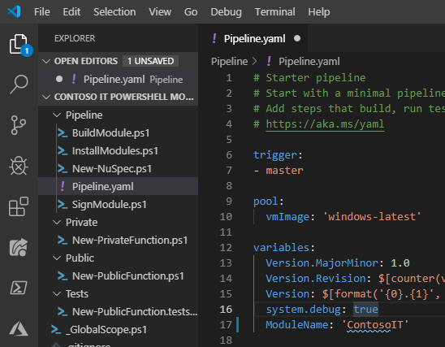
Update Pipeline.yaml

Slide 36
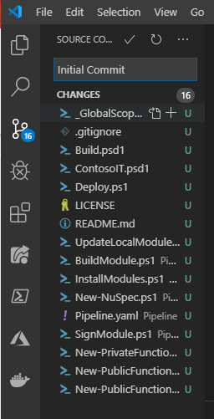
Commit Initial Version to Source Control

Slide 37
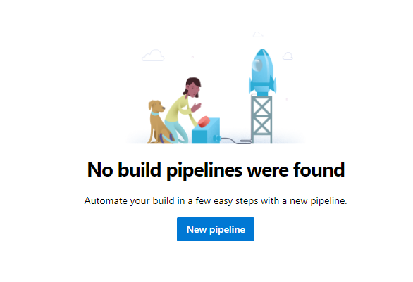
Create a new Pipeline

Slide 38
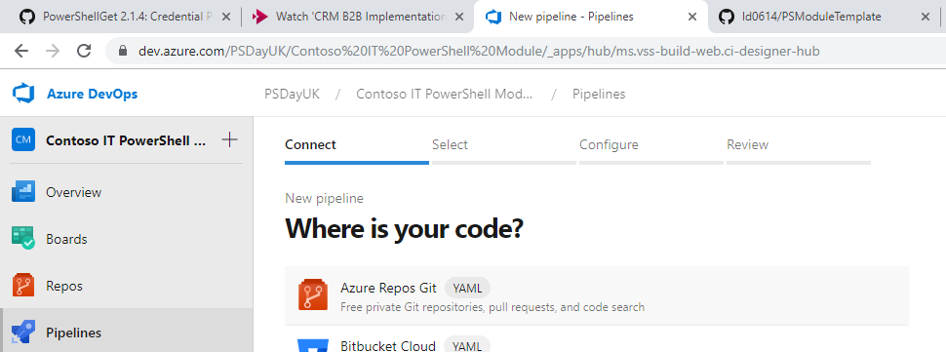
Select Azure Repos Git

Slide 39
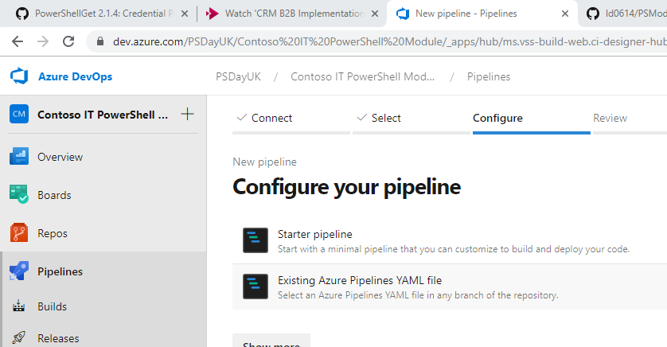
Existing Azure Pipelines YAML File

Slide 40
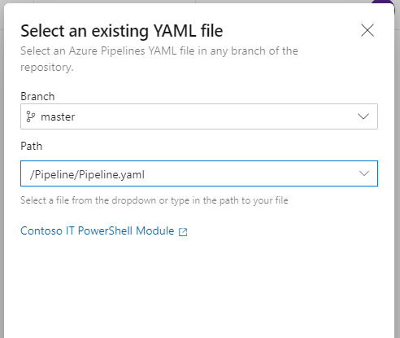
Select YAML File

Slide 41
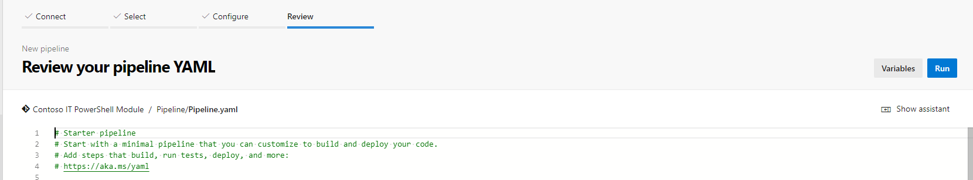
Click Run

Slide 42
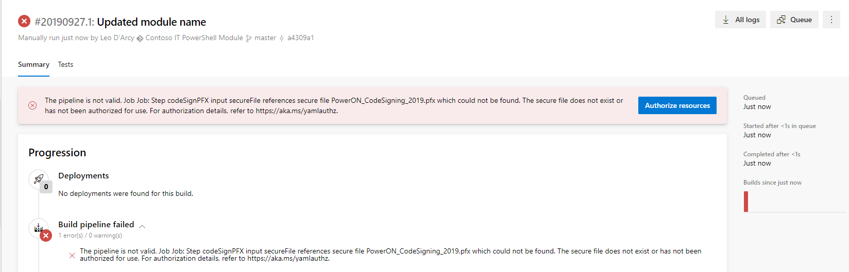
An Error will be returned

Slide 43
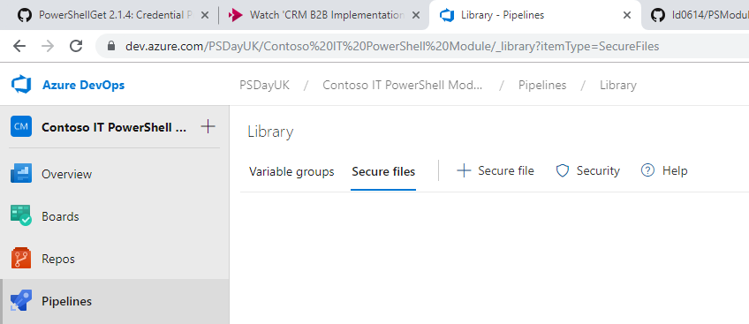
If Code Signing Certificate is Available Add it

Slide 44
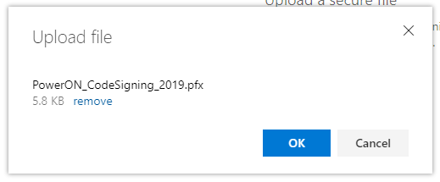
Locate and upload certificate PFX

Slide 45
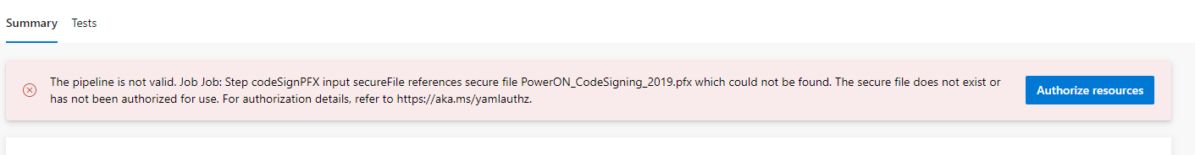
Return to failed build and click Authorize Resources

Slide 46
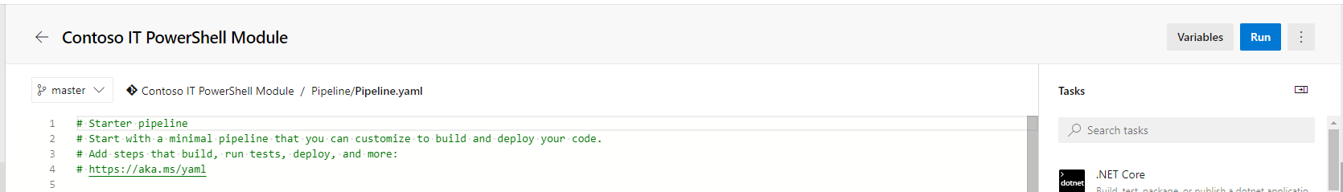
Edit Pipeline, select Variables

Slide 47
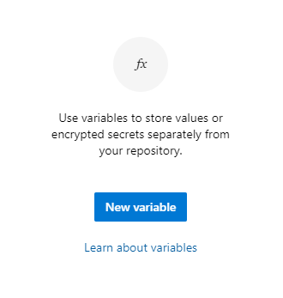
Create a new Variable names CodeSigningPassword

Slide 48
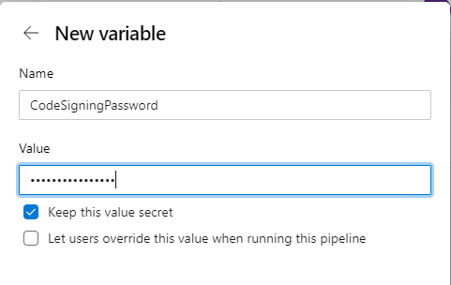
Create Secret Variable

Slide 49
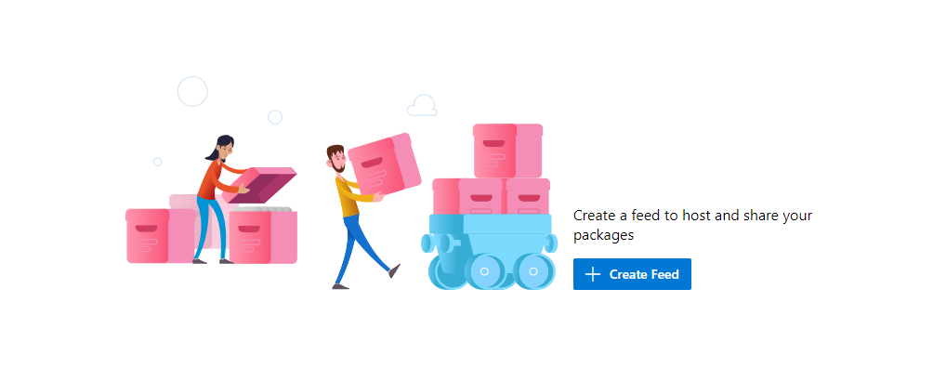
Create a new Feed

Slide 50
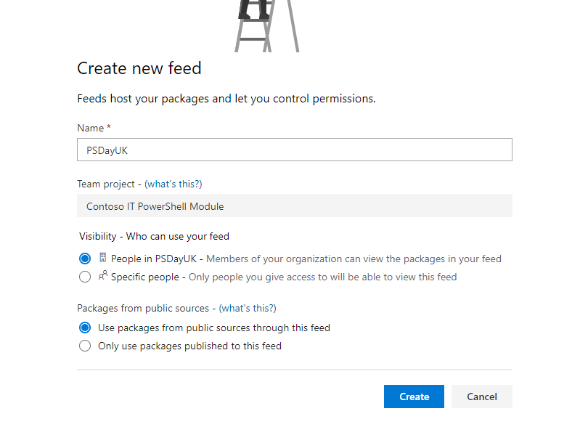
Fill in details

Slide 51
Edit the Pipeline

Slide 52
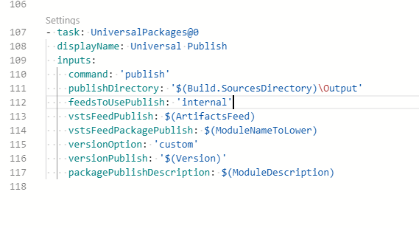
Navigate to UniversalPackages and click Settings

Slide 53
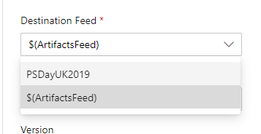
Select the Destination Feed

Slide 54
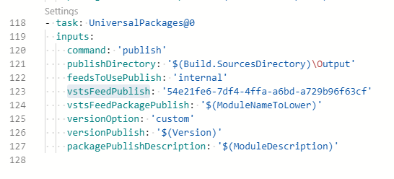
Click Add and copy the vstsFeedPublish GUID

Slide 55
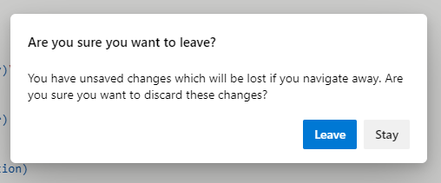
Don’t save the Pipeline

Slide 56
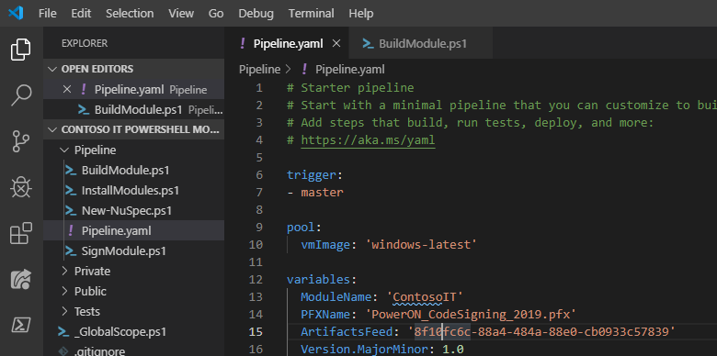
Update the ArtifactsFeed property in VS Code

Slide 57
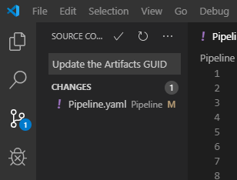
Push the updated code

Slide 58
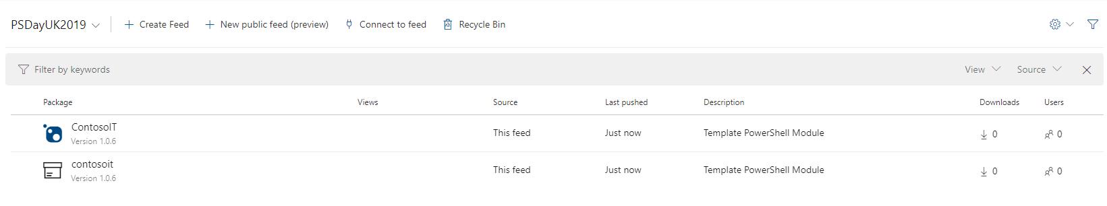
Artifacts are now in the Artifacts section

Slide 59
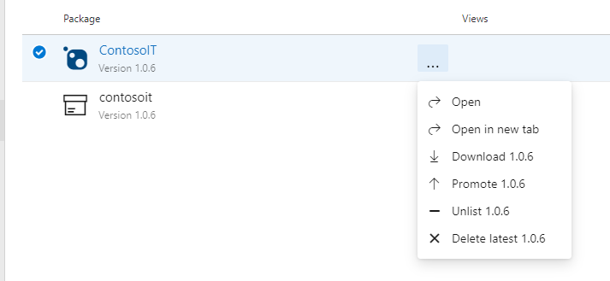
Nuget packages can be directly downloaded

Slide 60
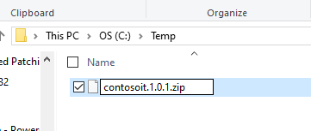
Rename the nupkg file to zip

Slide 61
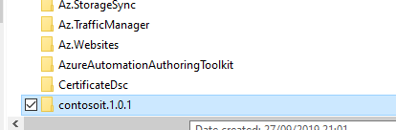
Copy Folder to Modules Directory

Slide 62
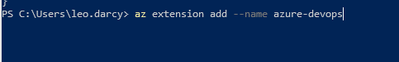
With Azure CLI, download DevOps extension

Slide 63
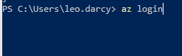
Login to Azure

Slide 64
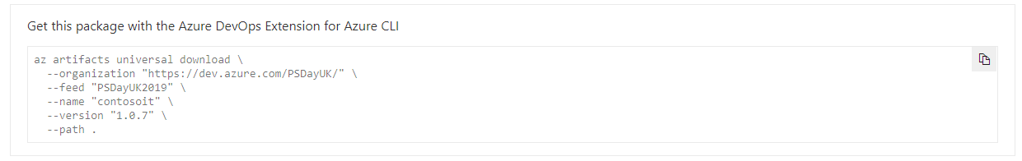
Copy the download command from DevOps

